Slide 1


SWEN261 Team - D
R2 Demonstration

Slide 2
Team Members
Moisés Lora Pérez, Team Coordinator
Michael Hopkins, Test Coordinator
Tyler Collins, Configuration Manager
Yancarlos Diaz, Development Coordinator
Bryan Camp, Requirements Coordinator

Slide 3

Presentation Schedule
General Product Design
Special Requirements for our client
Product walkthrough
Demo Presentation
Known Bugs
Reflections
Notes:
Moisés

Slide 4
General Design of the Project
The design was focused on being user friendly.
We created a design and color scheme that we implemented into every view making sure to not change the experience with each new page.
We made things work as the user would want them to work.
For example: Admins are able to log in at the general user login page and will automatically be taken to the admin page.
The user’s experience is streamlined and focused to help productivity and usability.
Notes:
Other examples: We designed a nav bar for easier navigation across the pages for the user. We didnt have this in our UI show and tell last week.
Bryan

Slide 5

Special Requirements
We have two differences when comparing our product to similar applications. These changes were documented and accepted by our client.
The two differences are:
We removed the Upload requirement. Instead we implemented a notification system that provides information to the users.
Nurses were originally required to view prescriptions. We talked to our client and removed that requirement. Instead they can now admit and discharge patients.

Slide 6
Special Requirements (cont.)
Notification System
The notification system alerts users whenever a new change is made. Notifications are produced for Medical Test results, new prescriptions, new appointments, and new messages.
Nurse Admit/Discharge
We felt that nurses do not need to see prescriptions because they can see it normally on the charts when they interact with patients. Instead they can now Admit/Discharge patients because they are the people that handle walk in patients.

Slide 7

Demo Presentation
Agenda:
Patient Registration / Profile Editing
Administrator Registration | Changing user permissions
Update Medical Information and Patient Transfer
Admitting and Discharging
Changing Primary Physician
Create, Delete, and View Appointments
User permissions and functions
Add, Remove, and View Prescriptions and Release and View Test Results
Logging System and Activity Log
System Statistics
Notes:
Tyler
Bryan Works the computer
Yan:
First we will show the login screen along with registering a new user
Users once they log in can easily access the site, due to the built in django authentication.
Doctors and Nurses use the same login but not the same registration
Doctors and Nurses have to be created by the admin
Moises:
Discuss the Calendar and Navigation
Tell the audience that
Michael
Talk about how appointments will work
Talk about the fields they will need to enter and where the appointments would show up if they were working
We discussed this problem earlier in the presentation.
Tyler
Talk about viewing the profile and editing
Mention that not all fields needed to register can be edited in this view
The admin is able to edit these fields
Bryan
Talk about the admin page
Log in as an admin via the admin page
Talk about the model disconnect and the need for a user and person view
Explain how to navigate to the activity log
Go to the activity log

Slide 8
Our Testing Process
When we implemented a feature we ran testing for that feature.
Testing was done by running the app and trying to perform a function.
Any functionality that was missing we were able to easily correct.
We implemented a function that produces a partially filled database. This function is called whenever there is no database present.
Notes:
Michael

Slide 9
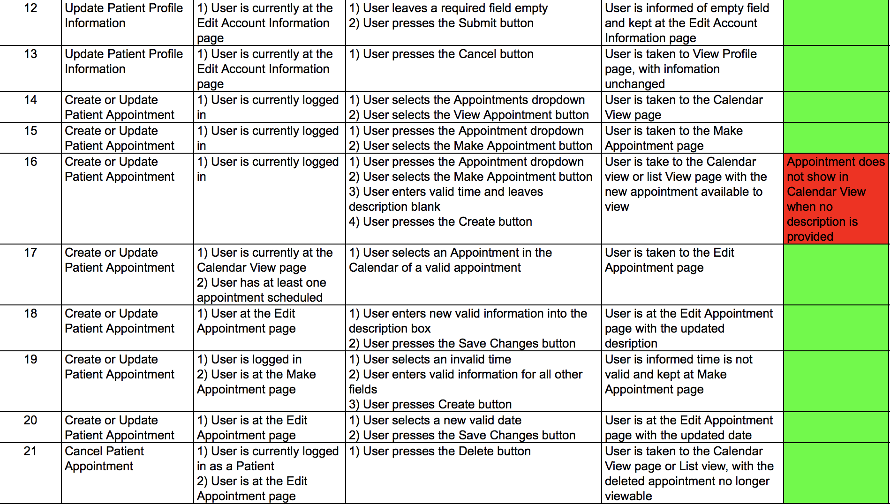
Our Test Cases
Notes:
Michael

Slide 10

Known bugs/Problems
Scarce warning system
Appointment editing does not work as intended
If a field is left blank when creating a new prescription, the site will crash
When a nurse makes an appointment, the name of the Dr appears as “Dr. Dr. LastName”
Notes:
Yan

Slide 11
Reflections
Things we would have changed:
A better warning system
Negotiation of extraneous requirements
Things that we wouldn’t have changed:
User design and experience
Moisés being late...
Notes:
Yan

Slide 12
Any Questions?

